Slide 1
UML
State Diagrams

Slide 2
What are state diagrams?
“… a familiar technique to describe the … lifetime behavior of a single object”
Martin Fowler – UML Distilled

Slide 3
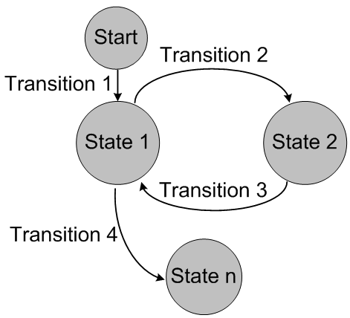
Other facts
Also called
State machine diagrams
State chart diagrams
Correlates to finite-state machines or finite-state automaton
Mathematical models
Represent abstract machines in Computer Science
Circuit logic
Computer programming

Slide 4
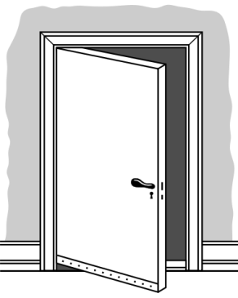
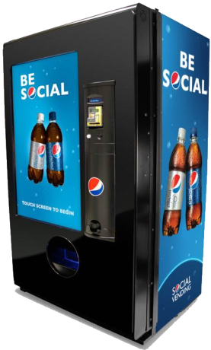

States and transitions
State diagrams are built from:
A finite set of states
Transitions between states
Examples
Door
States: open, closed, locked, unlocked
Transitions: open door, lock door
Vending machine
States: idle, partial payment, vending, enter user choice
Transitions: add money, vend item, dispense change
Registration
States: in progress, locked, completed, incomplete
Transitions: verify username/password, user verifies email

Slide 5
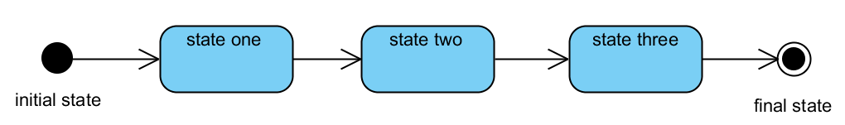
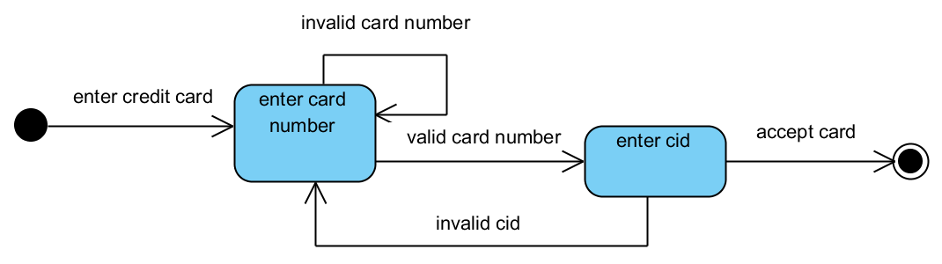
Initial and final states
Initial state: the starting state of an object
Final state: that has no transitions to other states

Slide 6
Transitions
Format:
trigger [guard] / effect
Trigger (event)
An event that starts a potential transition
Optional: the transition happens immediately
Guard
A boolean expression that must be true for the transition to be successful
Optional: the transition is always taken when the event occurs
Effect
An outcome that is executed if the transition is successful
Optional: no extra outcome happens with the transition

Slide 7
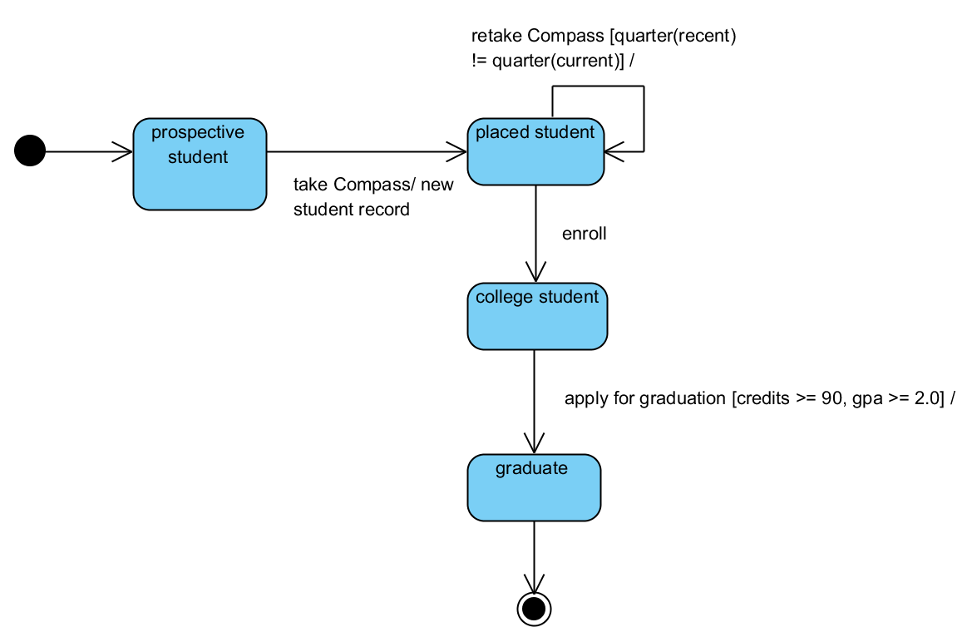
Transitions

Slide 8
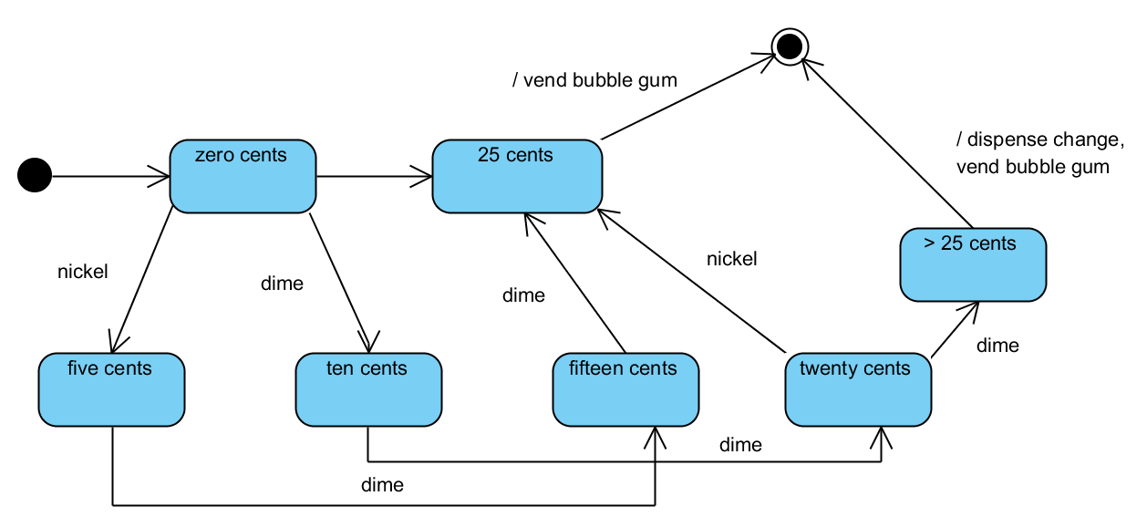
Example state machine
Create a finite state machine for a vending machine that accepts nickels, dimes and quarters and then dispenses bubble gum for 25¢

Slide 9
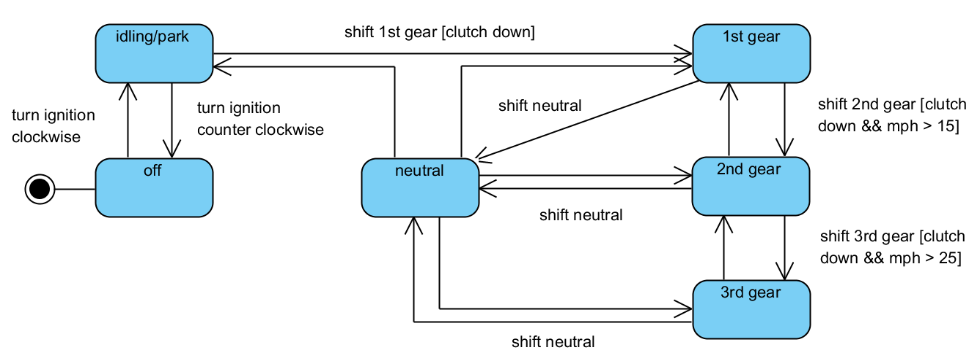
Example state machine
How would you model a stick-shift car?
Clutch?
Different gears?

Slide 10

Try it yourself!
Solve the following Old World Puzzle by modeling the problem using a state machine diagram
Note: each state can be drawn using two sections to denote the entities on each side of the river (ie. WC|GB denotes the wolf/cabbage are on one bank and goat/boat are on the other bank)
“A peasant finds himself on a riverbank with a wolf, a goat and a head of cabbage. He needs to transport all three to the other side of the river in his boat. However, the boat has room for only the peasant himself and one other item (either the wolf, the goat, or the cabbage). In his absence, the wolf would eat the goat, and the goat would eat the cabbage. Solve this problem for the peasant or prove it has no solution.”

Slide 11
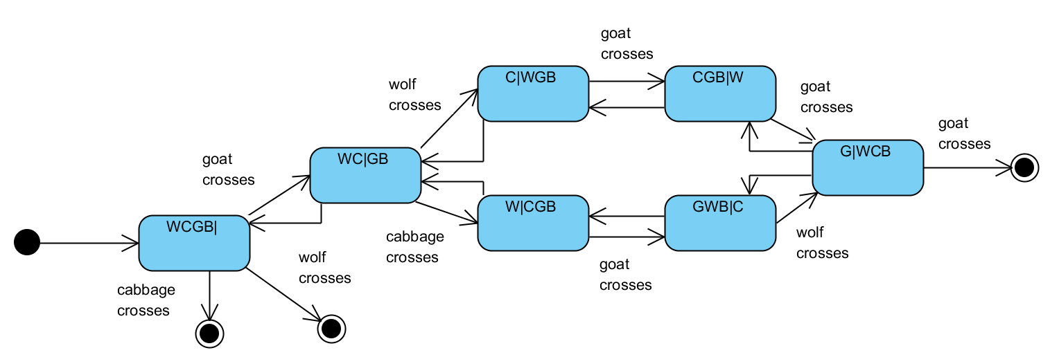
Solution

Slide 12
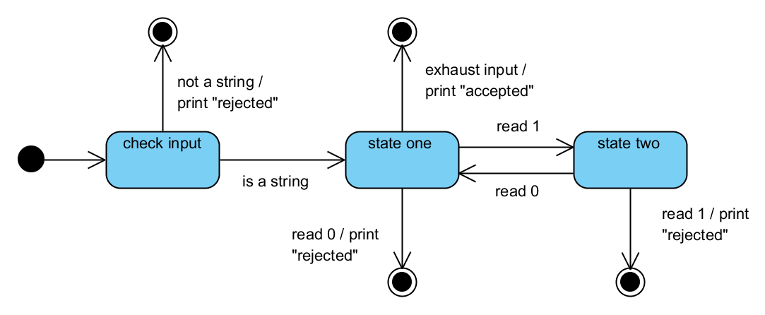
Try it yourself!
Build a statement machine that accepts an object and prints out the following:
“accepted” if the object is a string with the format 101010 … 10
“rejected” otherwise

Slide 13
Sources
Fowler, Martin. UML Distilled. New Jersey: Pearson Education, 2004.

Slide 14
UML
State Diagrams

